Slide 1

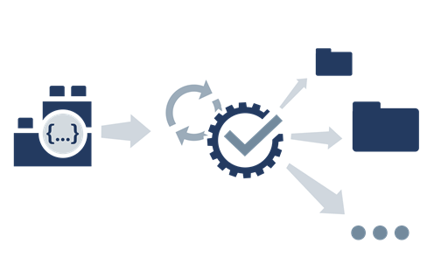
AUTOMATION TESTING
COPYRIGHT © 2018 By Khanh.tx@live.com at Testmaster.vn

Slide 2
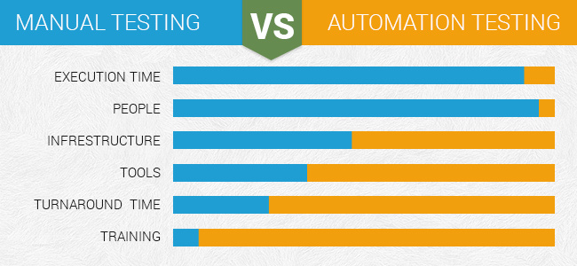
WHAT IS AUTOMATION TESTING?
Manual Testing is performed by a human sitting in front of a computer carefully executing the test steps, compare expected and actual result and create test reports.
Automation Testing means using a automation tool to execute test case suit for human replacement
The goal of Automation is to reduce the number of testcase to be run manually and not to eliminate Manual Testing altogether

Slide 3
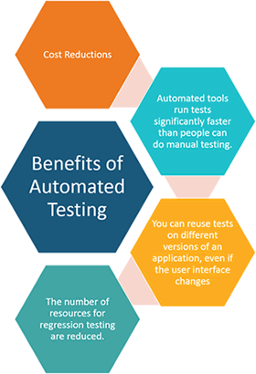
WHY AUTOMATED TESTING?
Automated software testing is important due to following reasons:
Manual Testing of all workflows, all fields, all negative scenarios is time and money consuming
It is difficult to test for multilingual sites manually
Automation does not require Human intervention. You can run automated test unattended (overnight)
Automation increases the speed of test execution
Automation helps increase Test Coverage
Manual Testing can become boring and hence error-prone.

Slide 4
WHICH TEST CASES TO AUTOMATE?
Test cases to be automated can be selected using the following criterion to increase the automation ROI (Return On Investment)
High Risk - Business Critical test cases
Test cases that are repeatedly executed
Test Cases that are very tedious or difficult to perform manually
Test Cases which are time-consuming
The following category of testcase are not suitable for automation
Test Cases that are newly designed and not executed manually at least once
Test Cases for which the requirements are frequently changing
Test cases which are executed on an ad-hoc basis.

Slide 5
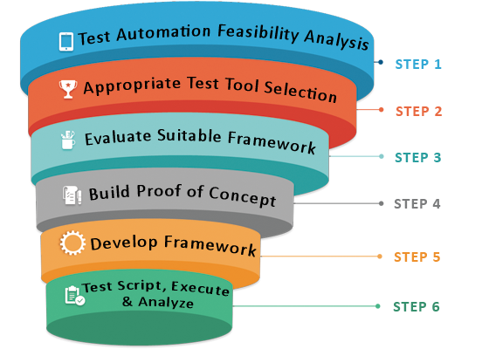
AUTOMATED TESTING PROCESS
Notes:
STEP 1: Phân tích tính khả thi của Automation Test
STEP 2: Lựa chọn Test Tool phù hợp
STEP 3: Đánh giá sự phù hợp của Framework (Nói về tầm quan trọng của framework)
STEP 4: Xây dựng các thử nghiệp
STEP 5: Xây dựng Framework
STEP 6: Thực hiện TestScript, phân tích kết quả test

Slide 6
HOW TO CHOOSE AN AUTOMATION TOOL
Selecting the right tool can be tricky task. Following criterion will help you select the best tool for your requirement
Environment Support
Ease of use
Object identification
Object Mapping
Scripting Language Used
Support for various types of test - including functional, test management, mobile, etc...
Support for multiple testing frameworks
Easy to debug the automation software scripts
Ability to recognize objects in any environment
Extensive test reports and results
Minimize training cost of selected tools
Tool selection is one of biggest challenges to be tackled before going for automation

Slide 7
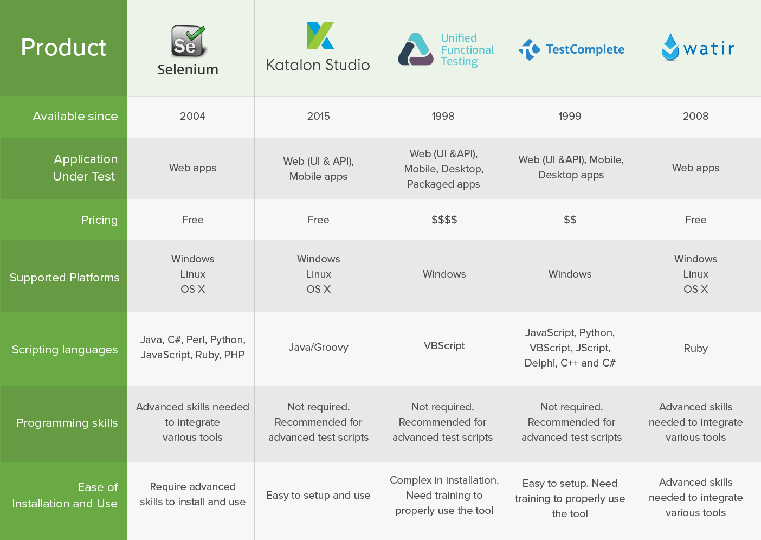
BEST AUTOMATION TESTING TOOLS

Slide 8
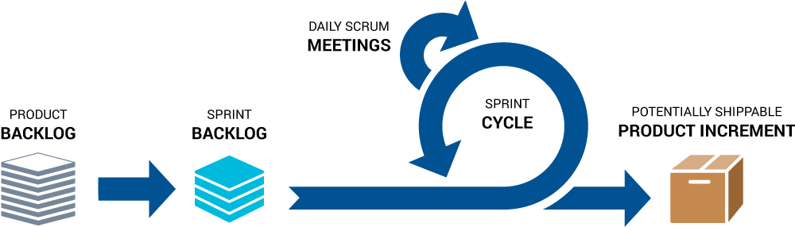
WHY AUTOMATION TESTING IS THE FUTURE OF TESTING

Slide 9
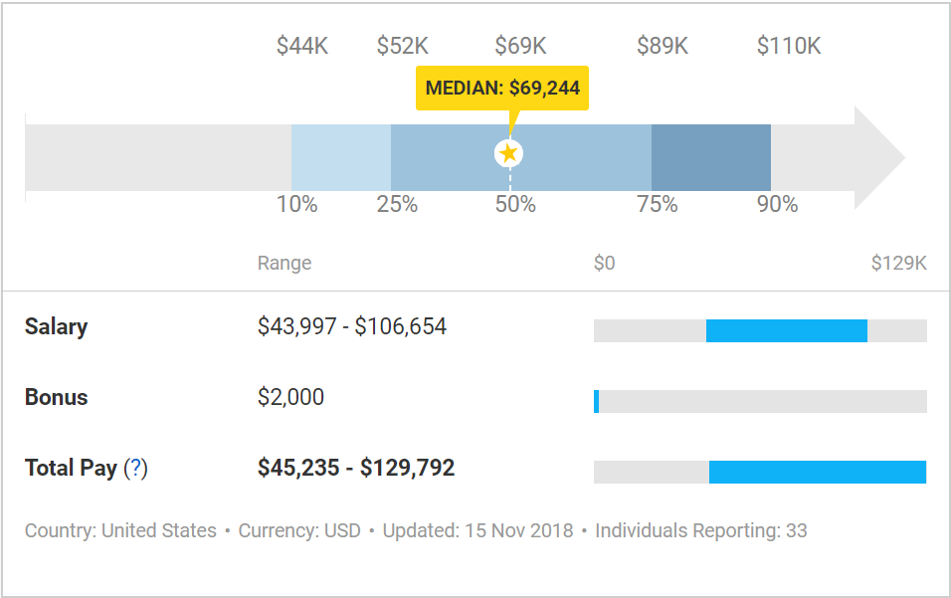
SALARY OF AUTOMATION TESTING

Slide 10
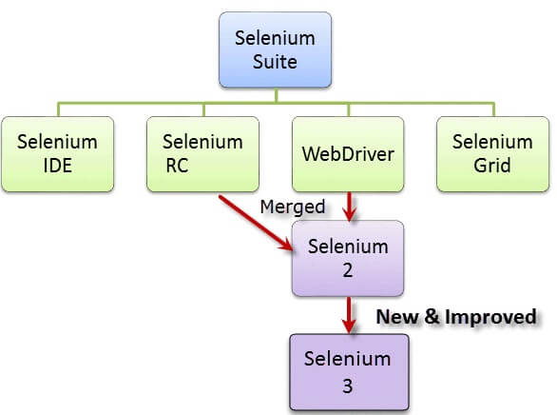
SELENIUM
Selenium is a free (open source) automated testing suite for Web Applications across different browsers and platforms.
It is quite similar to HP Quick Test Pro only that Selenium focuses on automating web-based applications. Testing done using Selenium tool is usually referred as Selenium Testing.
Created by Jason Huggins in 2004 – An engineer at ThoughtWorks. It has four components

Slide 11
HOW TO CHOOSE THE RIGHT SELENIUM TOOL FOR YOUR NEED
Tool | Why Choose?
Selenium IDE | To learn about concepts on automated testing and Selenium, including: Selenese commands such as type, open, clickAndWait, assert, verify, etc. Locators such as id, name, xpath, css selector, etc. Executing customized JavaScript code using runScript Exporting test cases in various formats. To create tests with little or no prior knowledge in programming. To create simple test cases and test suites that you can export later to RC or WebDriver. To test a web application against Firefox only.
Selenium RC | To design a test using a more expressive language than Selenese To run your test against different browsers (except HtmlUnit) on different operating systems. To deploy your tests across multiple environments using Selenium Grid. To test your application against a new browser that supports JavaScript. To test web applications with complex AJAX-based scenarios.
WebDriver | To use a certain programming language in designing your test case. To test applications that are rich in AJAX-based functionalities. To execute tests on the HtmlUnit browser. To create customized test results.
Selenium Grid | To run your Selenium RC scripts in multiple browsers and operating systems simultaneously. To run a huge test suite, that needs to complete in the soonest time possible.

Slide 12

SELENIUM IDE
Selenium Integrated Development Environment (IDE) is the simplest framework in the Selenium suite and is the easiest one to learn.
It is a Firefox plugin that you can install easily as you can with other plugins. Now, It already supported Chrome plugin
Selenium IDE should only be used as a Prototyping tool. If you want to create more advanced testcase, you will need to use either Selenium RC or WebDriver.

Slide 13
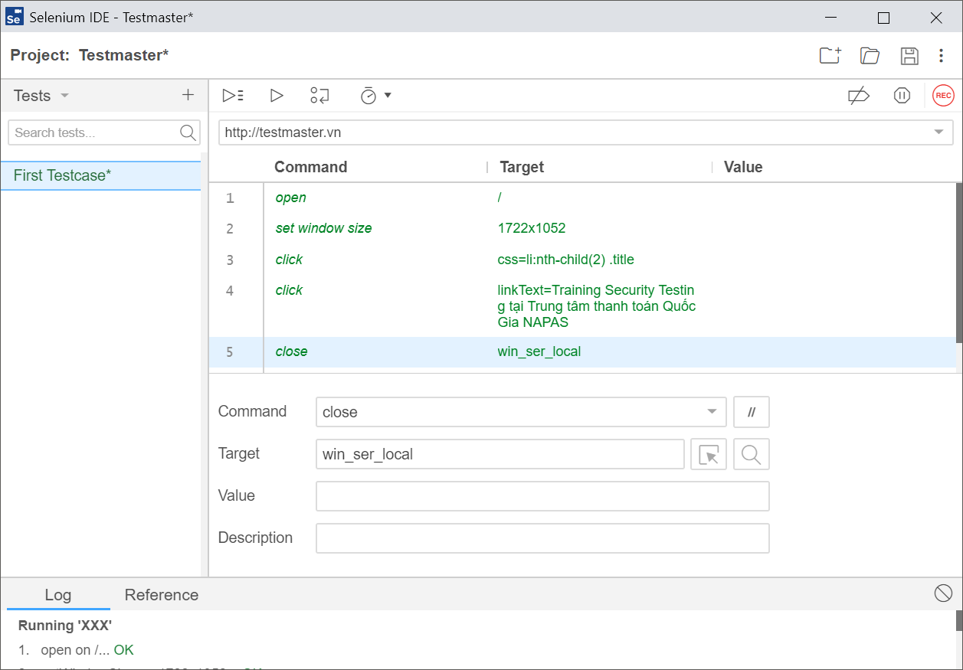
SELENIUM IDE
Installation
For Firefox: https://addons.mozilla.org/en-US/firefox/addon/selenium-ide/
For Chrome: https://chrome.google.com/webstore/detail/selenium-ide/mooikfkahbdckldjjndioackbalphokd
Start Selenium IDE
Address bar
Test Steps Edit Box
Test case list
Log, Reference

Slide 14
SELENIUM IDE COMMANDS
Open url: Opens a URL and waits for the page to load before proceeding. This accepts both relative and absolute URLs.
Send keys locator, key sequence: Simulates keystroke events on the specified element.
Click locator: Clicks on a target element (e.g. a link, button, checkbox, or radio button)
Mouse over locator: Simulates a user hovering a mouse over the specified element
wait for element present locator, wait time: Wait for a target element to be present on the page
wait for element not present

